Slide 1
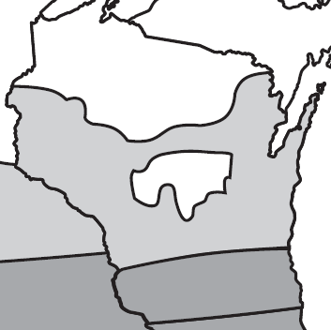
Not labeled for use
Region 4
a maximum of 0.25 lb ai/A of fomesafen may be applied in alternate years.
Region 3
a maximum of 0.313 lb ai/A of fomesafen may be applied in alternate years.
Region 3 (darker grey): south of U.S. Highway 18 between Prairie Du Chien and Madison, and South of Interstate 94 between Madison and Milwaukee.
Region 4 (lighter grey). Don’t use fomesafen-based products on white regions in the map. Figure adapted from Warrant Ultra label.

